Slide 1
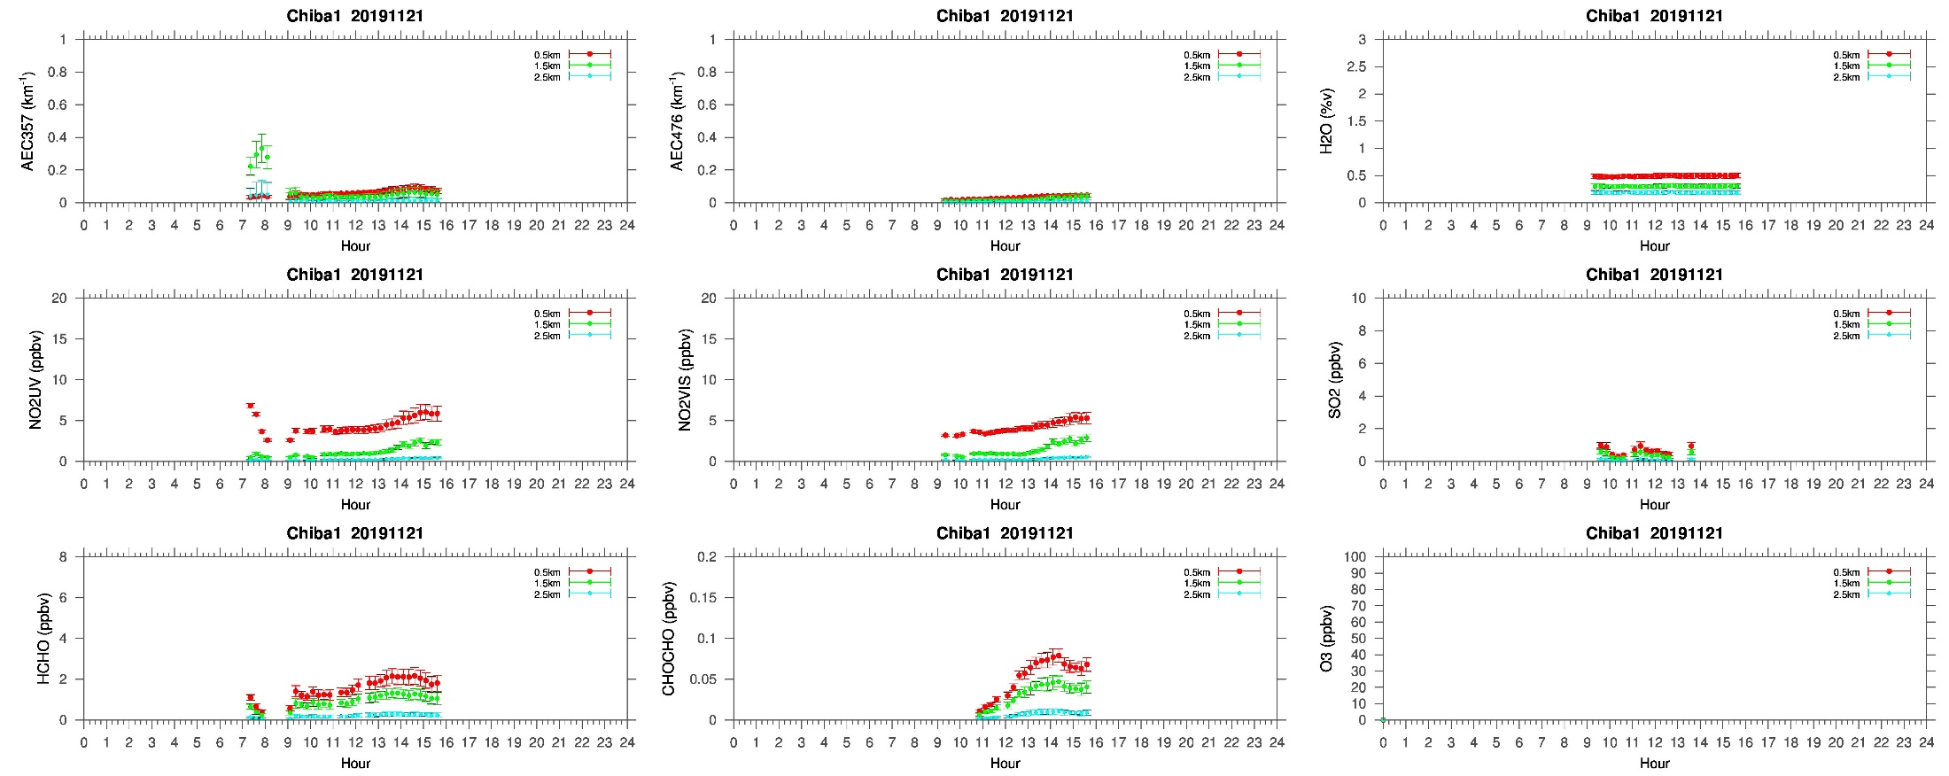
Elevated NO₂, HCHO, & CHOCHO conc. at 1-2 km
20191121
Values for 0-1 km
Values for 1-2 km

Slide 2
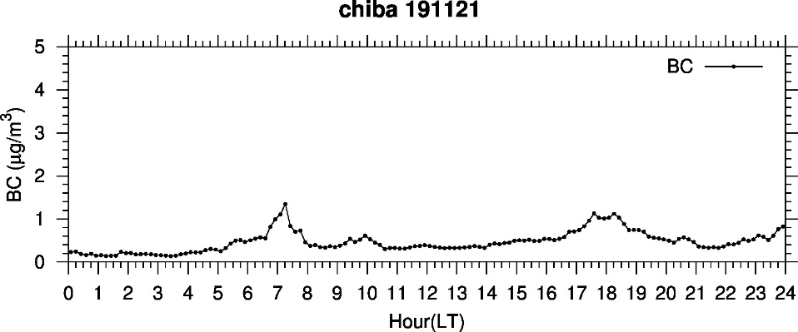
Decrease in SSA may be related to variations in MAX-DOAS trace gas data?
BC was not high, suggesting that the SSA decrease did not occur near the surface?

Slide 4
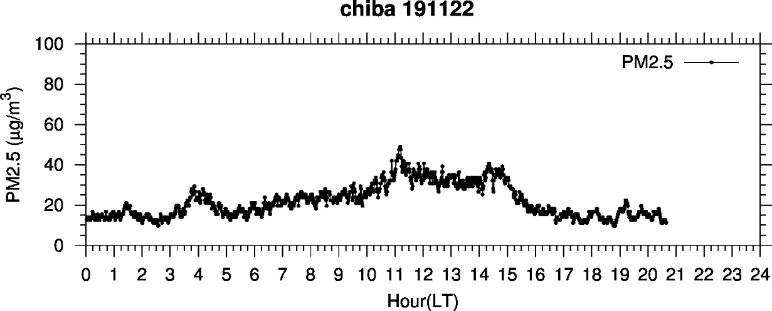
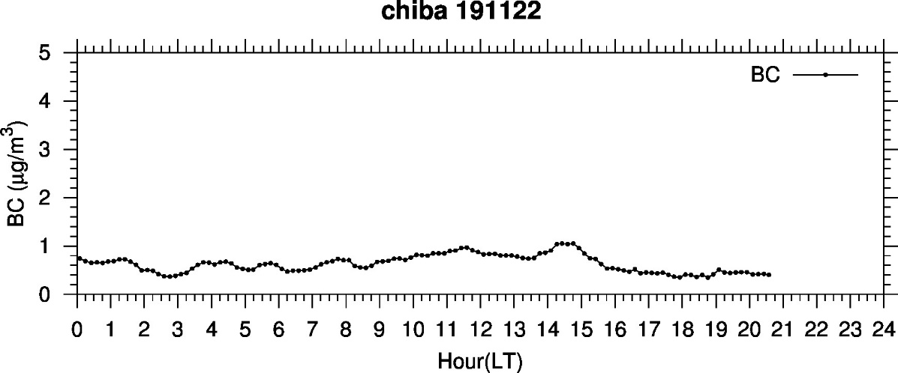
Significant amounts of PM_{2.5} and BC
were present even under rainy conditions

